Slide 1
Optoelectronic Devices:
An Introduction
DISPOSITIVI OPTOELETTRONICI
(6 CFU) 1st year, 1st semester
Master in Electronic Engineering
Lecturer: Mauro Mosca
(http://www.dieet.unipa.it/tfl/fundamentals%20optoelectronic%20devices.html)
last release: 27/09/2023
University of Palermo – Master in Electronic Engineering
Notes:
Hello, my name is Mauro Mosca, from University of Palermo, Italy, and I bid you welcome to the course of "Optoelectronic Devices". The course aims to provide you some advanced topics in the field of optoelectronic devices (light sources and photodetectors) and the communication at optical frequencies.
The aim of the course is not only to enhance knowledge of modern optoelectronic devices, but also to give you the methods and the tools to characterize them.
At the end of the course, you will gain the ability to communicate and express the issues concerning optoelectronic devices and their applications.

Slide 2


Who am I?
Associate professor at University of Palermo, Italy
Visiting professor at EPFL, Switzerland
Research activity:
Nitride semiconductor, LED and laser fabrication,
Hybrid LEDs, Nitride photodetectors,
Microtechnology and processing, Pulsed-laser
deposition of thin films, Carbon-Dot fabrication
and characterization
...AFTER
BEFORE...

Slide 3
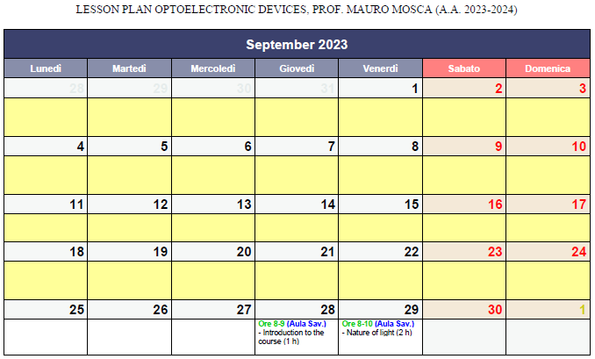

Slide 4
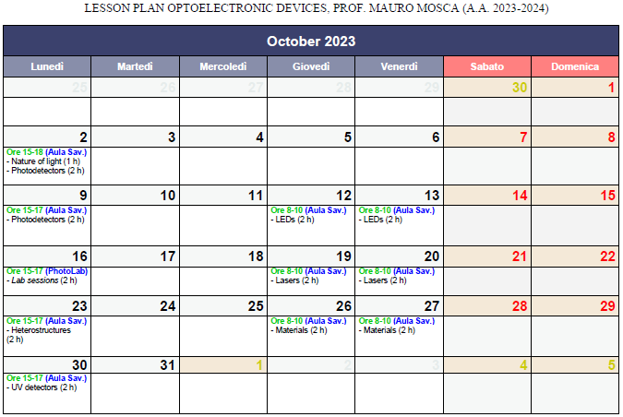

Slide 5
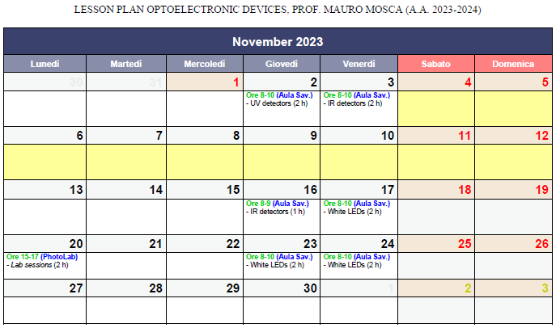

Slide 6
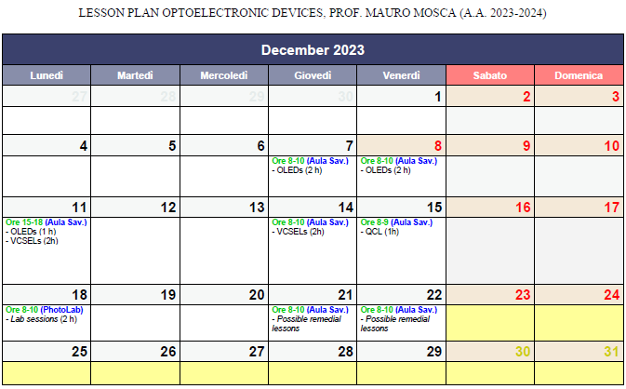

Slide 7
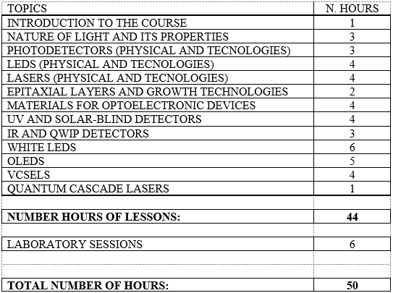

Slide 8
Goal of this course
Introduce the student to the principles of modern optoelectronics
Give several advanced topics on the otpoelectronic devices necessary to well understand complex systems
Sources and detectors
«standard»
devices
basic physical
principles
applications
fabrication
technologies

Slide 9

Exercise sessions
theoretical
laboratory sessions (on devices and systems)
(~ 12 hours, in 4 sessions)
if COVID-19 allows us...

Slide 10


Exams
knowledge of the physical and technological principles of optoelectronic devices
analytical skills,
ability to synthesize
and to present
8 + 14 + 10 = ...
+ 1
> 30 30 cum laude
A DETAILED
TALK ON ONE BETWEEN
TWO POSSIBLE TOPICS
DRAWN DURING
THE EXAM SESSION
(~15 min)
Where can I find materials for my paper?
WRITING AND
DISCUSSING AN
ARTICLE ON A
NON-TREATED TOPIC
BUT LINKED
WITH THE COURSE
(~10 min)
Laser Focus World (https://www.laserfocusworld.com/)
Photonics Spectra (https://www.photonics.com/Photonics_Spectra/p5)
LED materials (https://www.ledsmagazine.com/)
Electro Optics https://www.electrooptics.com/features)
Semiconductor Today (http://www.semiconductor-today.com/)
Compound Semiconductors (https://compoundsemiconductor.net/home)
A SHORT AND RAPID
QUESTIONNAIRE ON
THE DIFFERENT TOPICS
OF THE COURSE
(~5 min)
(14 PTS.)
+
1 BONUS POINT
for an excellent and
well-detailed presentation
(8 PTS.)
(10 PTS.)

Slide 11


Suggested texts…
… and tested suggestions
Notes and teaching materials provided by the teacher
(http://www.dieet.unipa.it/tfl/teaching%20material.html)
J. Singh: Semiconductor Optoelectronics, : Physics and technology,
Mc-Graw-Hill, Inc. (1995)
S. M. Sze, M. K. Lee: Semiconductor Devices. Physics and Technology (3rd edition),
John Wiley & Sons, Inc. (2012)
E. F. Schubert: Light-Emitting Diodes (2nd edition), Cambridge Univ. Press (2006)
- D. Sands: Diode lasers, IoP Publishing (2005)
don't take too many notes (you have teaching materials) but follow the
lessons carefully
study and work in groups: exchange opinions !!
try to work more in the classroom than at home:
sometimes it is hard not to yawn but try to use efficiently your time
do not leave gaps in your preparation
(means: do not omit to study "unpleasant" or complex topics)

Slide 12
Prerequisites (...what I need to know?)
Courses
  Electronic Devices
  Physics
  Electronics
Topics
  Semiconductor Physics (conduction and valence bands, direct and indirect band gaps, conduction in semicondutors...);
  Elements of Quantum Mechanics (potential wells, quantum-wells...);
  Elements of Solid-State Physics.
  (crystal planes and lattices, Miller indices, Brillouin zones,…);
  Some elements of material growth and device fabrication technologies
  Fundamentals of Optics

Slide 13

Course syllabus
BASIC OPTOELECTRONIC DEVICES
Light: its nature and its properties
Photodetectors
Light-emitting diodes (LEDs)
Lasers
Epitaxy and heterostructures
(or not?...)
maybe a refresher
for students of modern electronics
or those who attend courses of Optoelectronics,
Heterostructure devices, Photonics...

Slide 14
Course syllabus
ADVANCED OPTOELECTRONICS
Optoelectronic Materials
UV “solar-blind” Photodetectors
IR Photodetectors and Quantum-Well Infrared Photodetectors (QWIP)
OPTICAL-ELECTRICAL CONVERSION
(DETECTORS)

Slide 15
Course syllabus
ADVANCED OPTOELECTRONICS
ELECTRICAL-OPTICAL CONVERSION
(SOURCES: LEDS)
White LEDs
Organic LEDs (OLEDs)

Slide 16
Course syllabus
ADVANCED OPTOELECTRONICS
ELECTRICAL-OPTICAL CONVERSION
(SOURCES: LASERS)
Vertical-Cavity Surface-Emitting Laser (VCSEL)
Quantum-cascade laser (QCL)

